Slide 1
AI Agent for Smart Farming Advice
IBM HACKATHON PROJECT
Presented By
Student name : Imran Maniyar
College Name & Department :MMIT & Computer Science

Slide 2
OUTLINE
Problem Statement
Technology used
Wow factor
End users
Result
Conclusion
Git-hub Link
Future scope
IBM Certifications

Slide 3
Problem Statement
Small-scale farmers struggle to access timely and localized agricultural information due to fragmented data sources, language barriers, and limited digital literacy. Critical farming decisions regarding crop selection, weather updates, pest control, and market prices often rely on outdated or generic advice, leading to reduced yields and financial losses. Traditional extension services have limited reach and cannot provide real-time, location-specific guidance needed for optimal decision-making.

Slide 4
Technology used
IBM cloud lite services
Natural Language Processing (NLP)
Retrieval Augmented Generation (RAG)
IBM Granite model

Slide 5
IBM cloud services used
IBM Cloud Watsonx AI Studio
IBM Cloud Watsonx AI runtime
IBM Cloud Agent Lab
IBM Granite foundation model

Slide 6
Wow factors
This agent will significantly reduce research time, improve the quality of literature reviews, help early-stage researchers find direction, and foster interdisciplinary collaboration by making knowledge more accessible and actionable.
Unique features:
Semantic search across research papers, journals, and datasets
Auto-summarization of selected papers
Citation and reference analysis to trace influence
Recommendation of research papers based on a user’s current topic
Trend analysis over time for specific keywords or domains
Collaboration mapping: suggests potential co-authors or institutions based on similar research interests

Slide 7
End users
Academic Researchers
farmers or agricultural stakeholders
Research Institutions and Universities
Educators

Slide 8
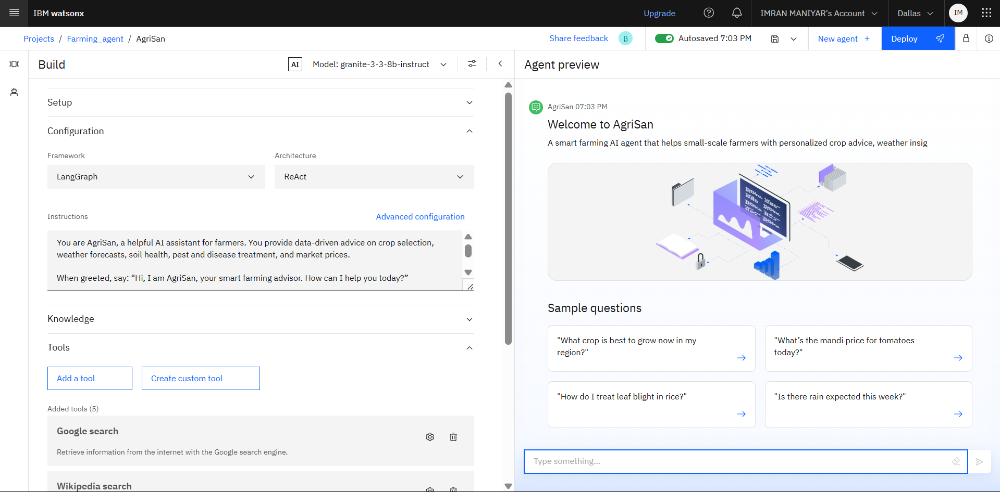
Results

Slide 9
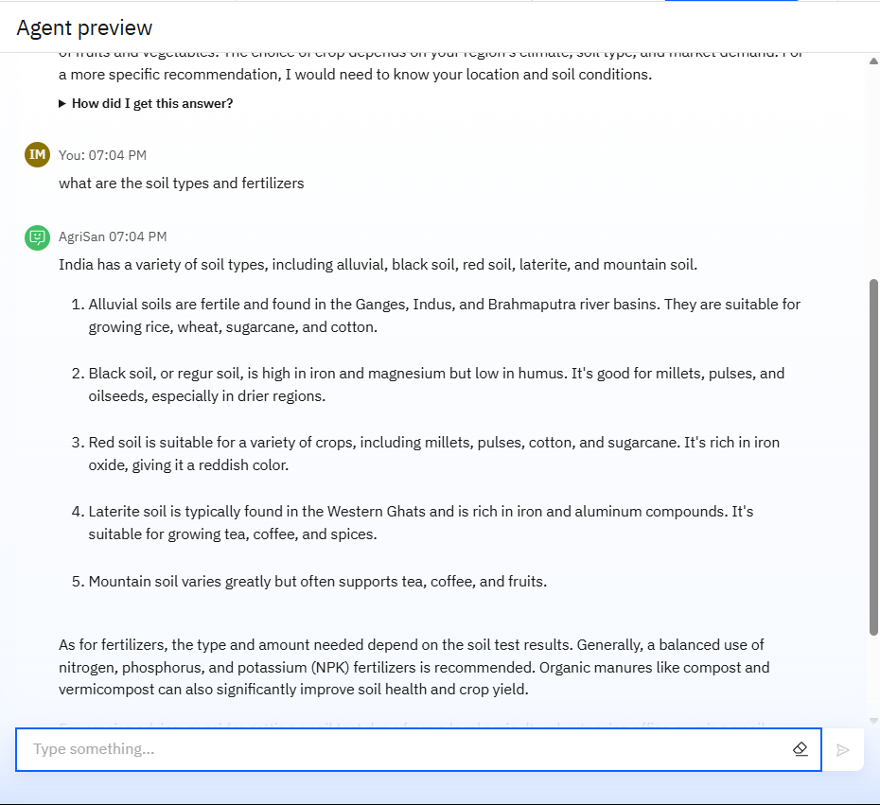
Results

Slide 10
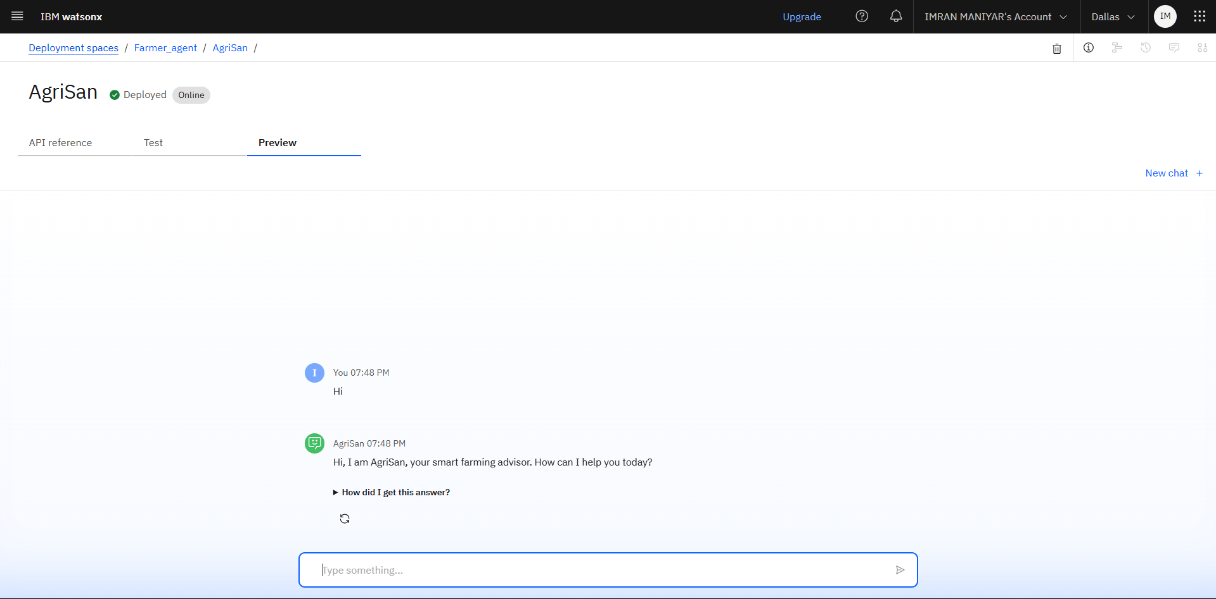
Results

Slide 11
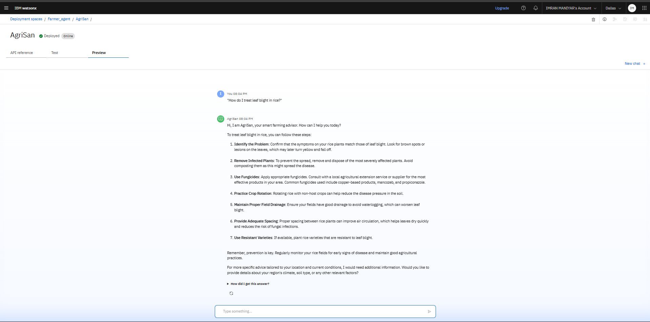
Results
Deployed AI Agent

Slide 12
Conclusion
Summarize the findings and discuss the effectiveness of the proposed solution. Highlight any challenges encountered during the implementation and potential improvements. Emphasize the importance of accurate bike count predictions for ensuring a stable supply of rental bikes in urban areas.

Slide 13
GitHub Link
https://github.com/Imranmaniyar007/AgriSan-AI-Agent.git

Slide 14
Future scope
Integration with IoT sensors for real-time soil and moisture data
Voice-based interaction for illiterate users
Expansion to other regions and languages
Use of edge computing for offline access
Collaboration with agritech startups and government schemes

Slide 15
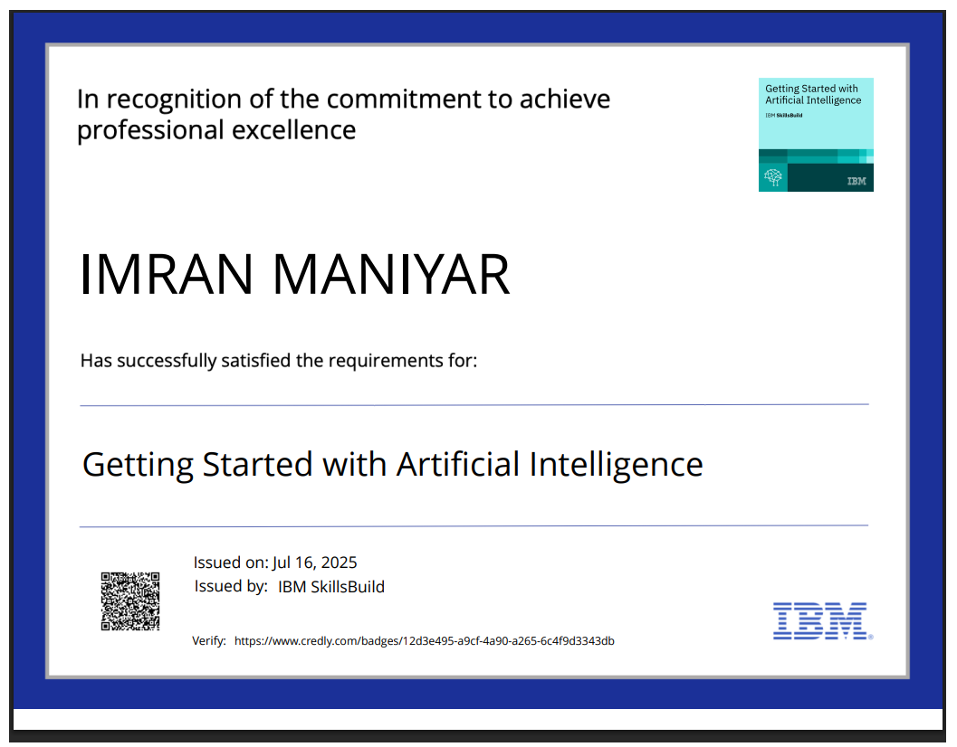
IBM Certifications

Slide 16
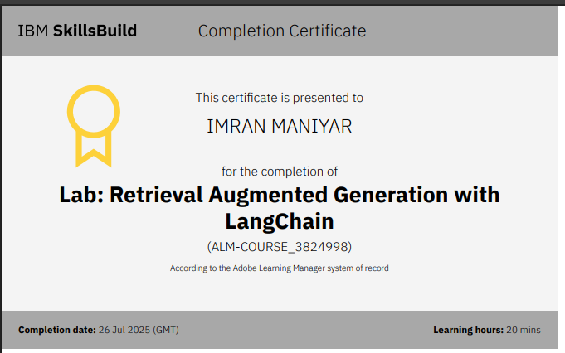

Slide 17
THANK YOU

